Slide 1
ARCHITECTURE

Slide 2
What is Architecture?
The art and technique of building with the help of scientific methods keeping in mind the utilitarian needs of the user.
Architecture is like a frozen music.
Architecture is a reflection of society, it is like a mirror.
A building tells a story of its own origin.

Slide 3
The art and science of designing and constructing buildings and other physical structures.

Slide 4
Types of Architecture
1. Indigenous Architecture
Is that in which construction done by using the materials available in that particular region.
2. Urban Architecture
The architecture in which foreign materials are used i.e. materials are imported.

Slide 5
Essential Qualities
The essential qualities in a building are:
Function
Stability
Beauty
In architecture beauty is not the most important
character instead function and stability have
greater importance. The form always follows
functions.

Slide 6
Typology
1. Chronological
2. Regional/ Cultural
3. By usage
4. By building material available

Slide 7
1. Chronological
Architecture can be divided in chronological order for example:
Egyptian
Greek
Byzantine and so on

Slide 8
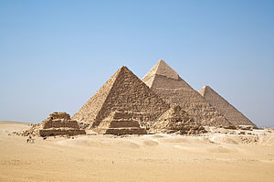
Egyptian Architecture

Slide 9
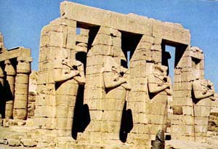

Slide 10
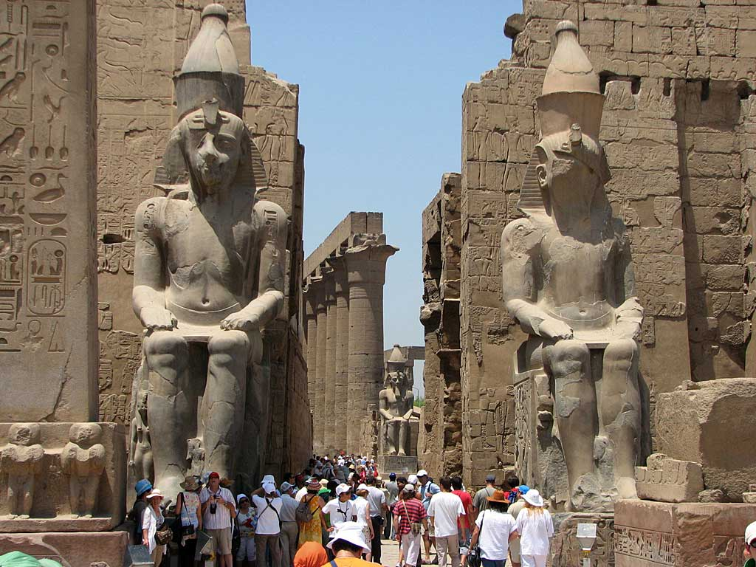

Slide 11
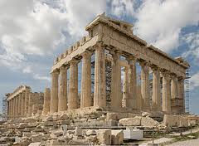
GREEK ARCHITECTURE

Slide 12
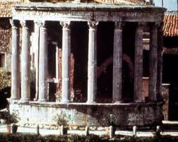

Slide 13
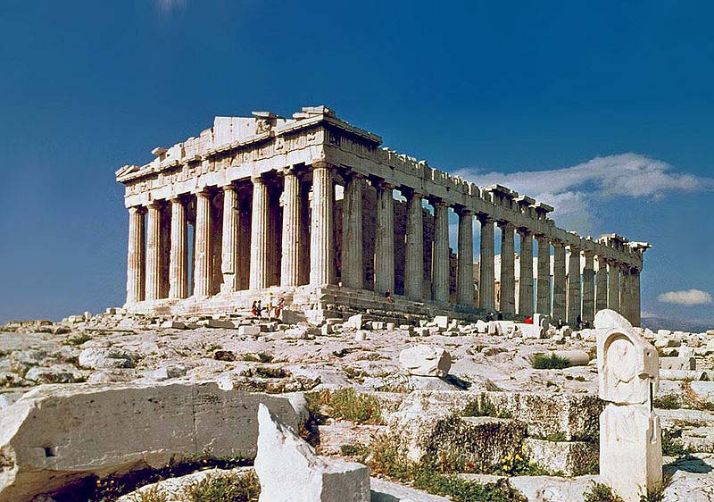

Slide 14
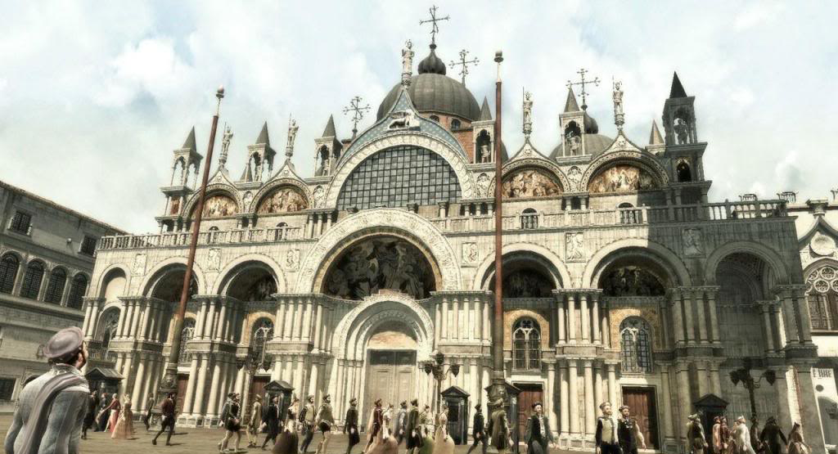
BYZANTINE ARCHITECTURE

Slide 15


Slide 16
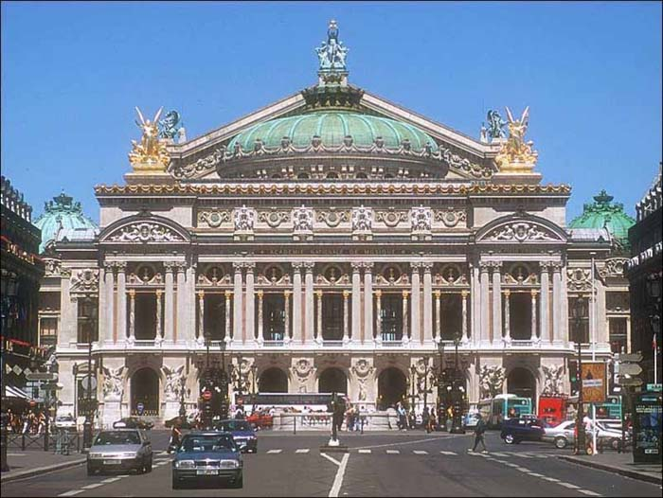

Slide 17
2. Regional/Cultural
Architecture can be classified by region and culture.
Indian
Chinese
Japanese
American
African
Islamic

Slide 18
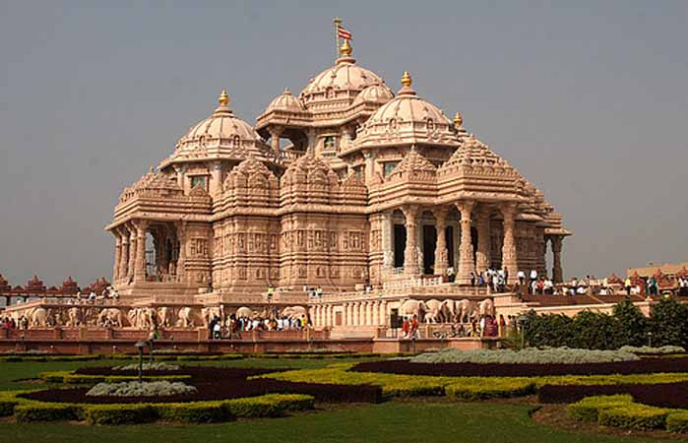
Indian

Slide 19
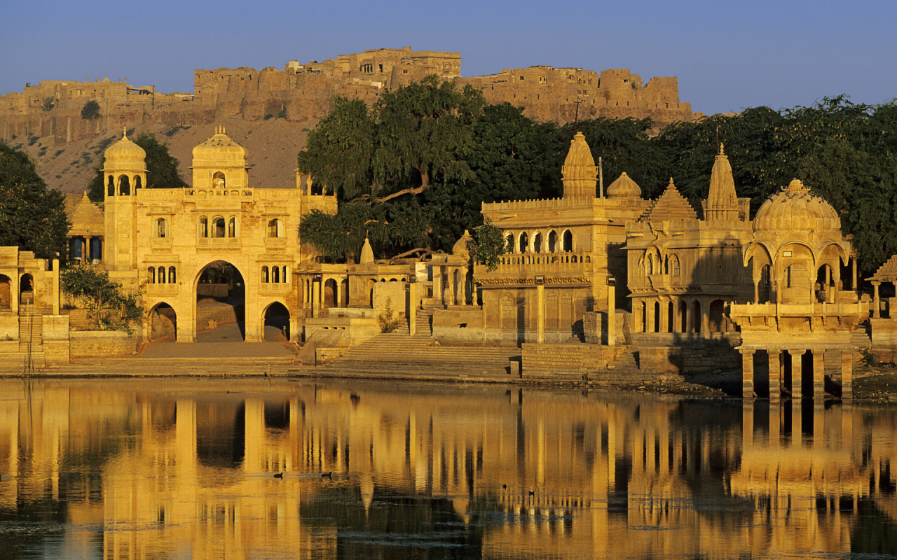

Slide 20
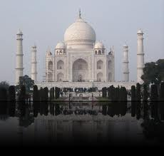

Slide 21
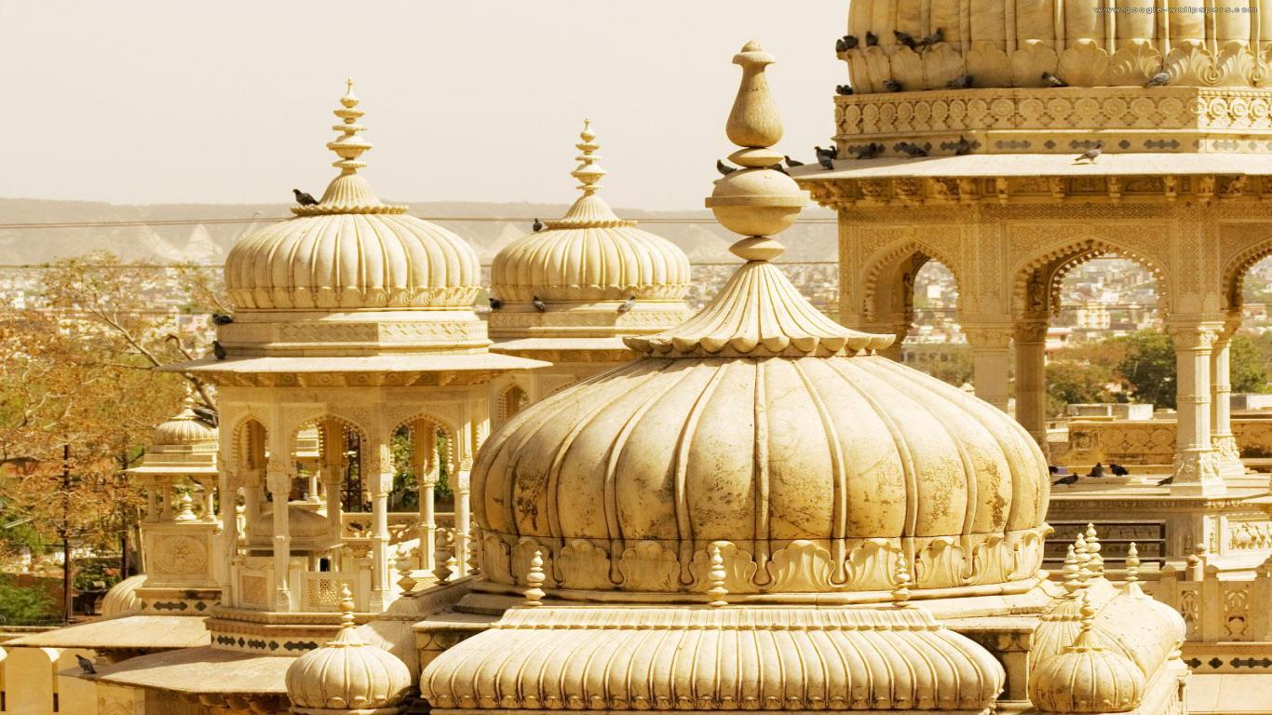

Slide 22
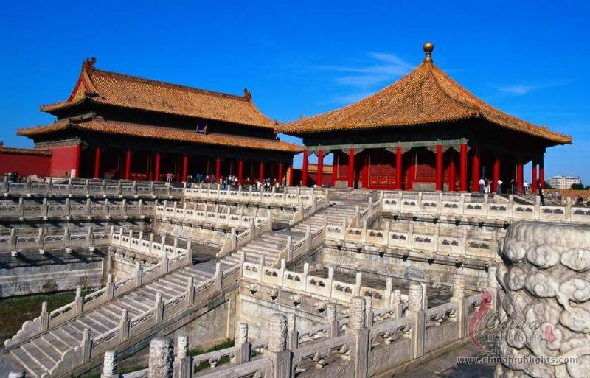
Chinese

Slide 23
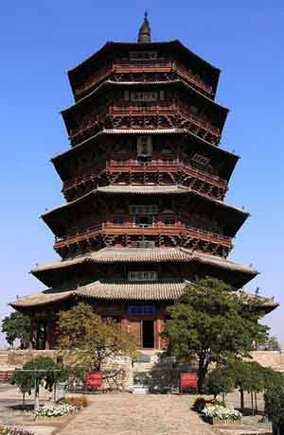
Chinese wooden Temple

Slide 24
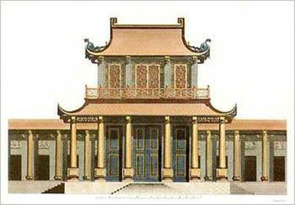

Slide 25
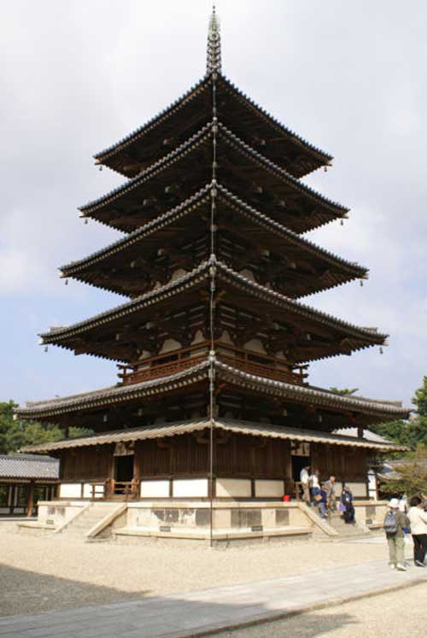
Japanese

Slide 27


Slide 28
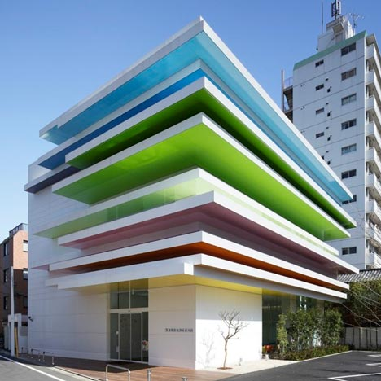
Contemporary Japanese Architecture

Slide 29
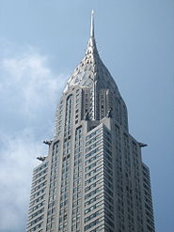
American: The Chrysler Building

Slide 30
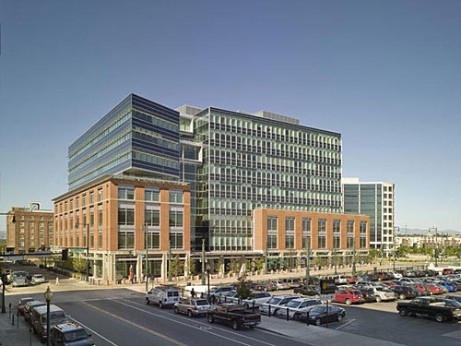

Slide 31
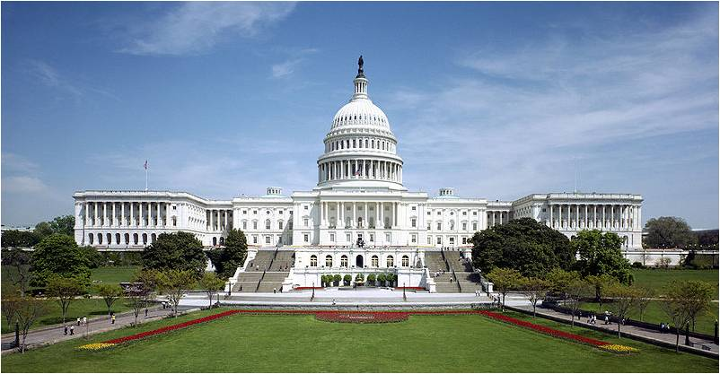

Slide 32


Slide 33


Slide 34
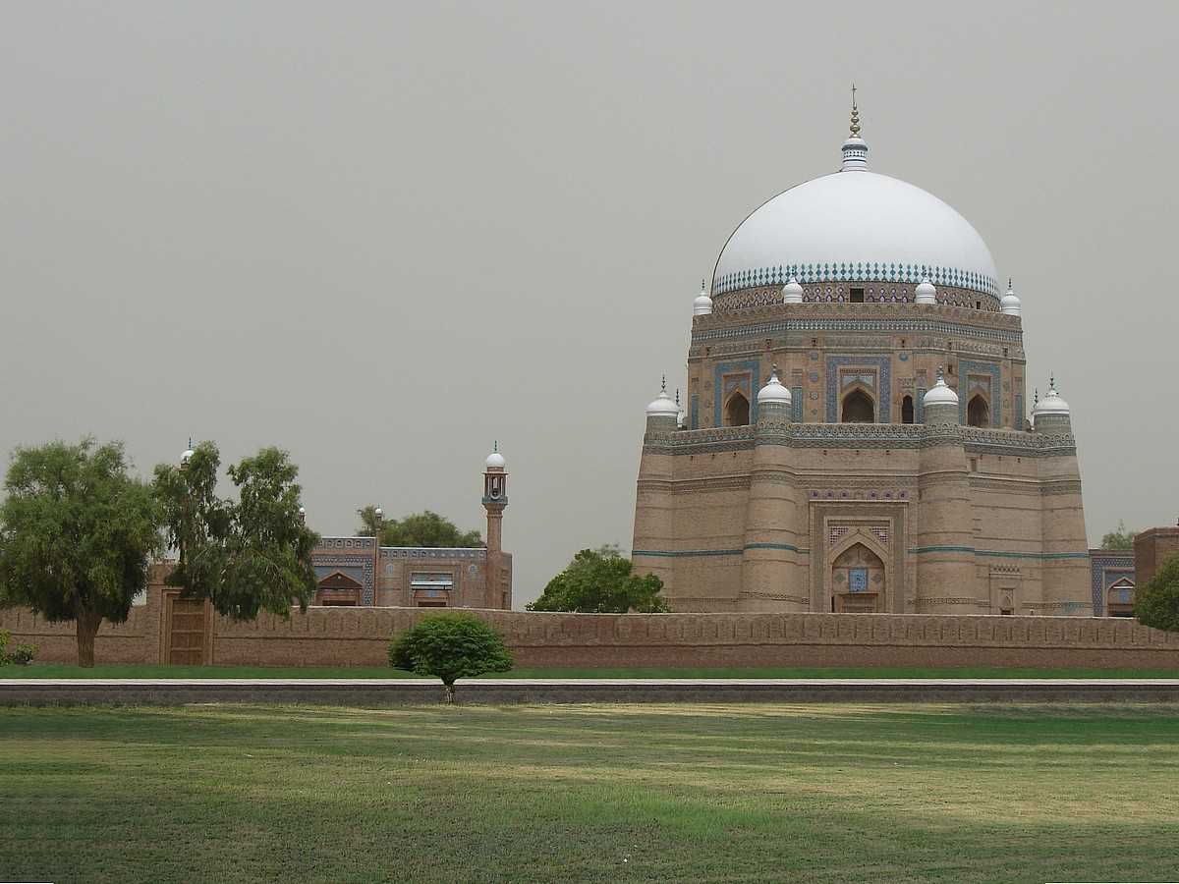
ISLAMIC

Slide 35
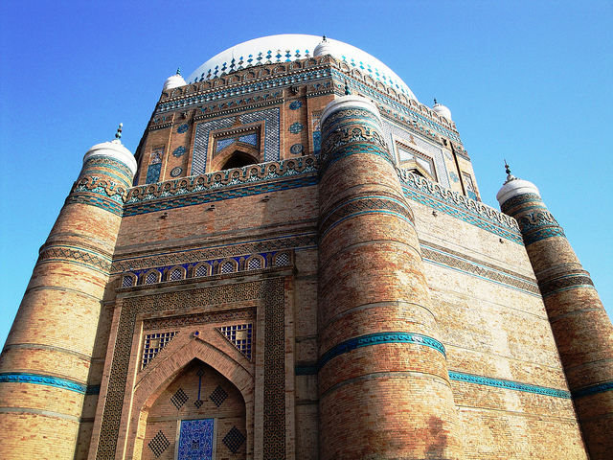

Slide 36
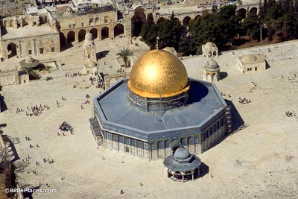
DOME OF THE ROCK

Slide 37
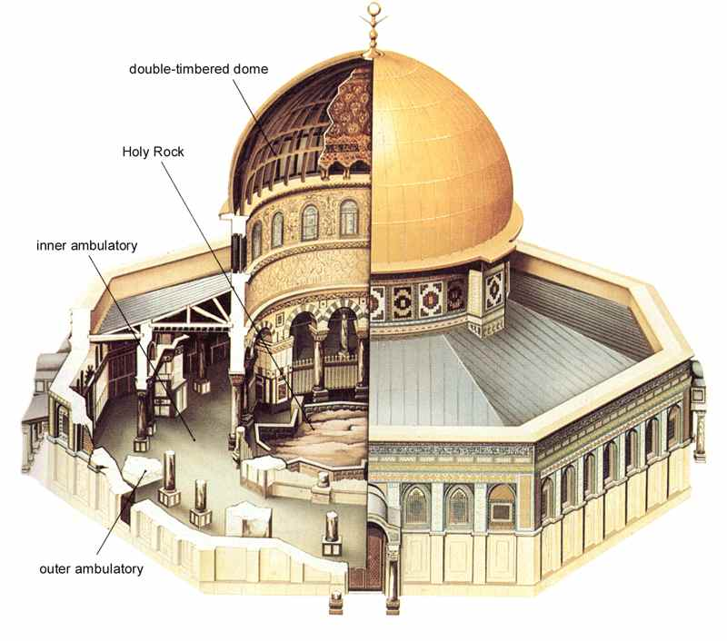
INTERIOR DRAWING

Slide 38
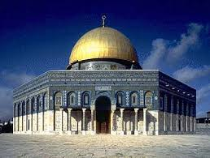

Slide 39
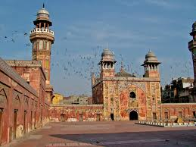
Wazir khan mosque

Slide 40
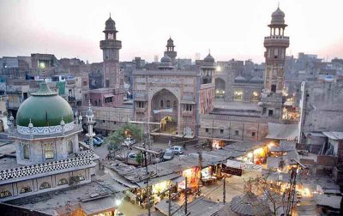

Slide 41

DOME OF WAZIR KHAN MOSQUE

Slide 42
3. By Usage
Domestic
Commercial
Industrial
Recreational
Educational
Welfare
Business
Governmental

Slide 43
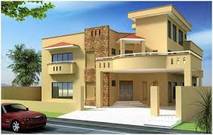
Domestic

Slide 44
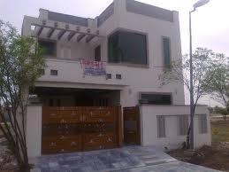

Slide 45
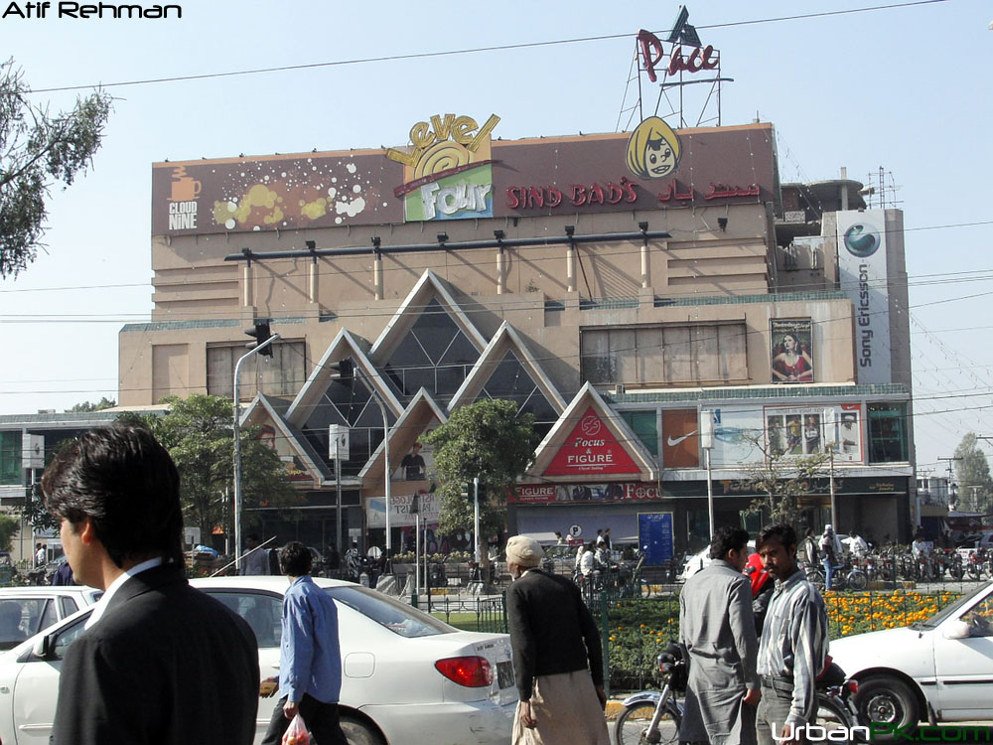
Commercial

Slide 46
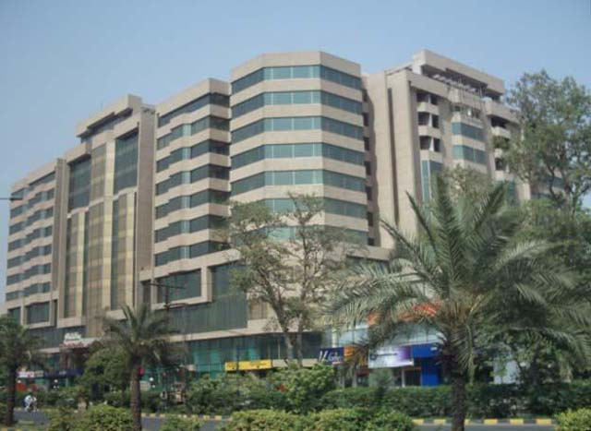
Siddiq Trade Centre Lahore

Slide 47
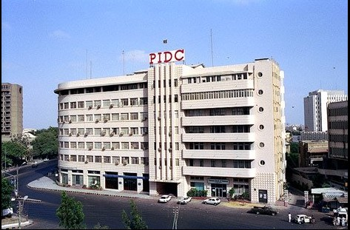
Industrial Buildings: PIDC

Slide 48
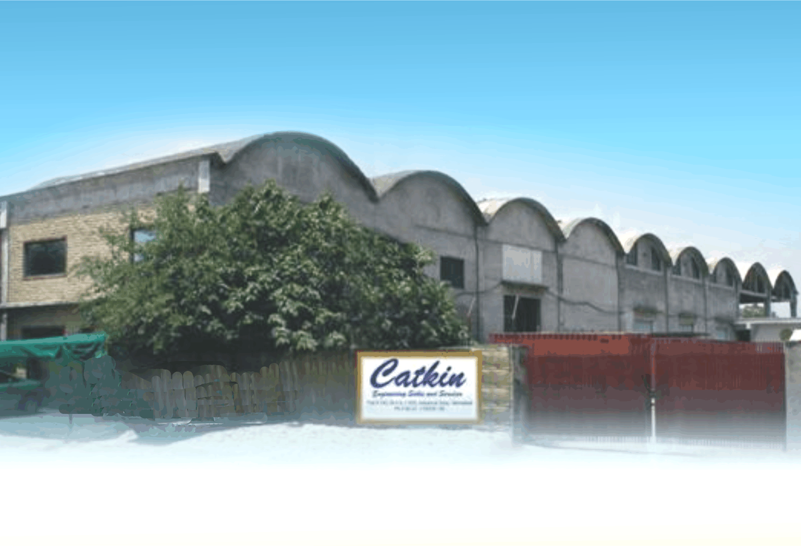
Catkin Engineering Service Centre

Slide 49
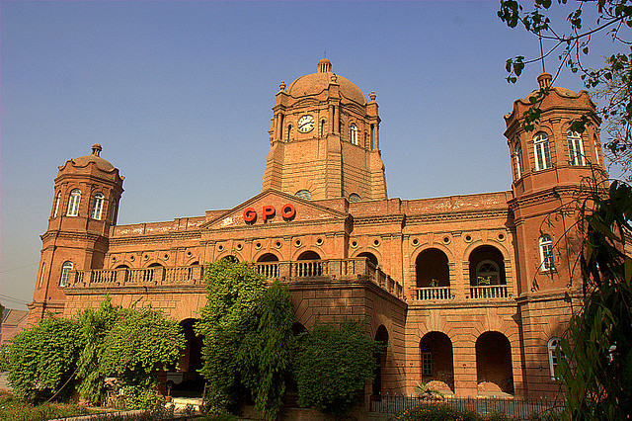
GOVERNMENTAL

Slide 50
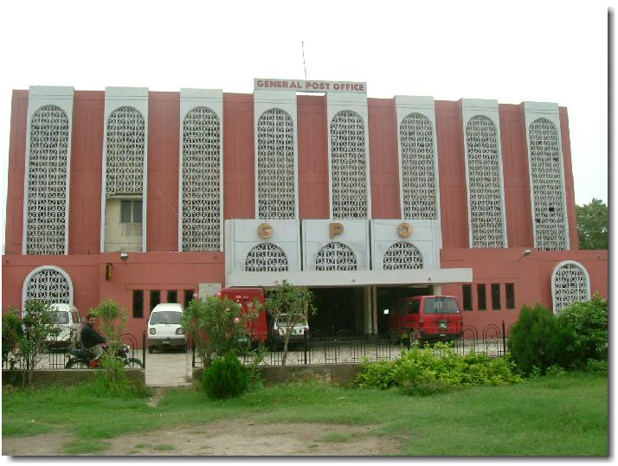
Faislabad GPO

Slide 51
4. By Building Material
Different types of building material can be used in architecture.
Highness
Stone
Mud
Steel
Concrete

Slide 52
Neolithic Architecture
The organization of settlements and the architectural structure of houses differed according to regions and periods and reflected environmental, economic and social changes taking place during the long Neolithic Period (6800-3200 BC). Building materials consisted of thick timber posts, reeds, clay (mud-bricks) and stone for the foundations and the upper structure (walls), while for roofing, tree trunks, reeds, clay and hay were used.

Slide 53
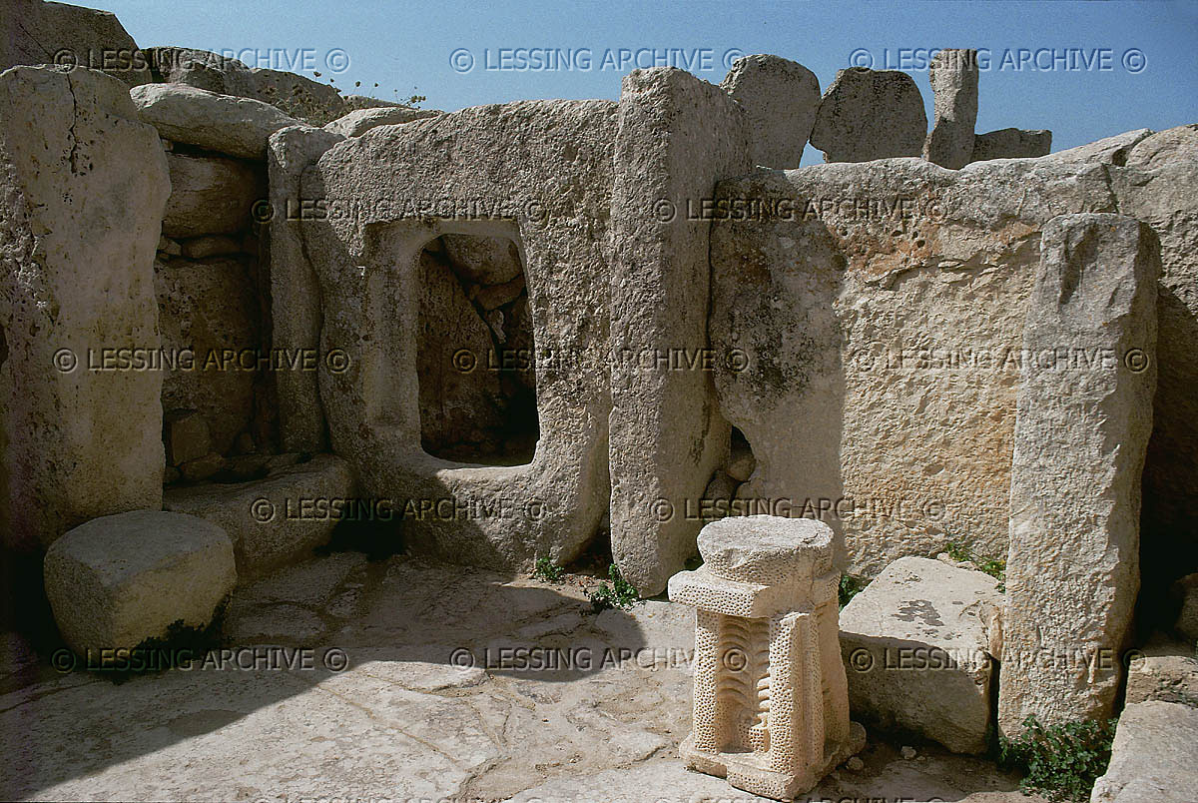

Slide 54
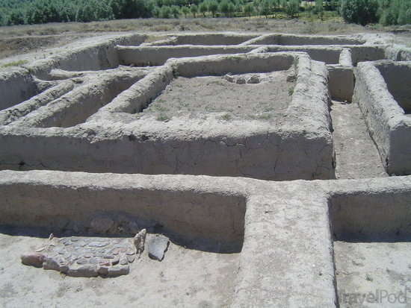

Slide 55
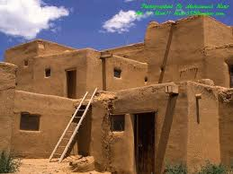
Mud Houses

Slide 56
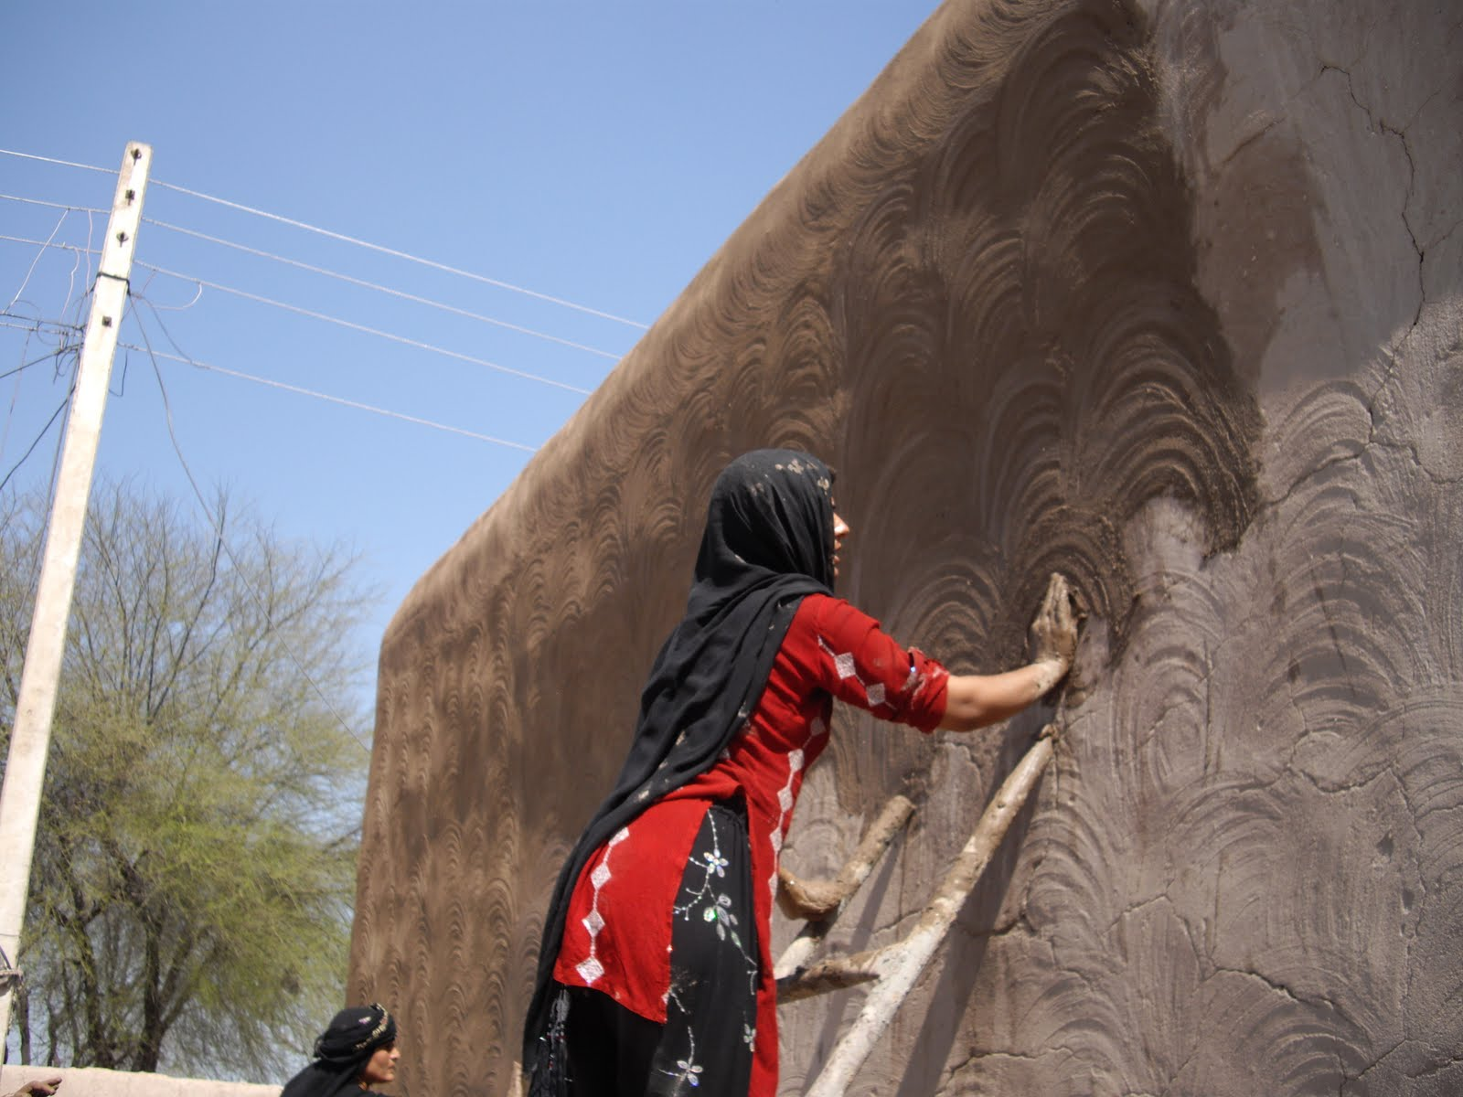

Slide 57
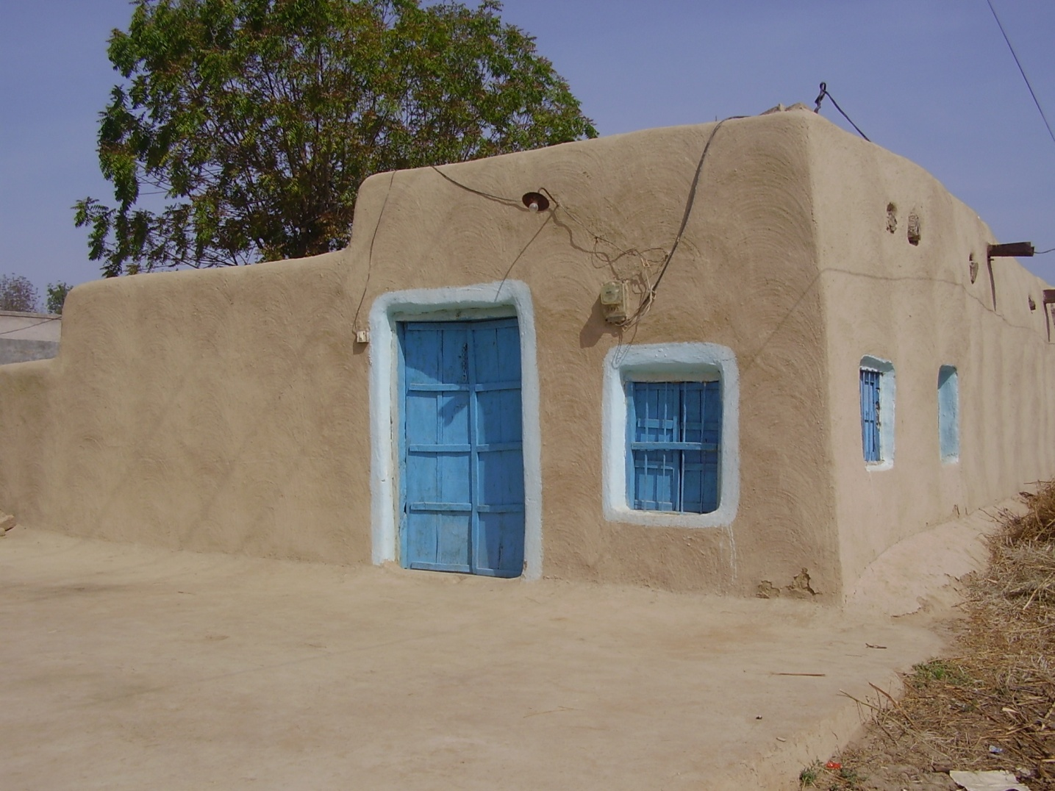

Slide 58
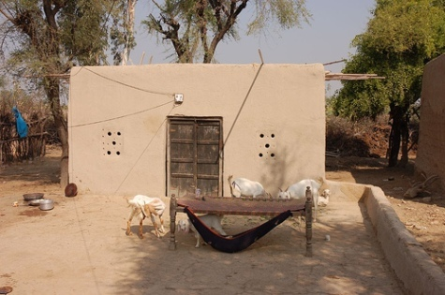

Slide 59
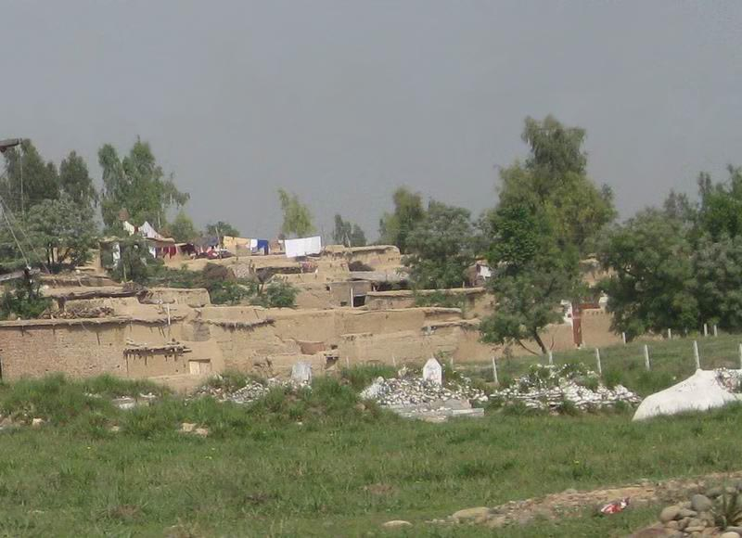

Slide 60
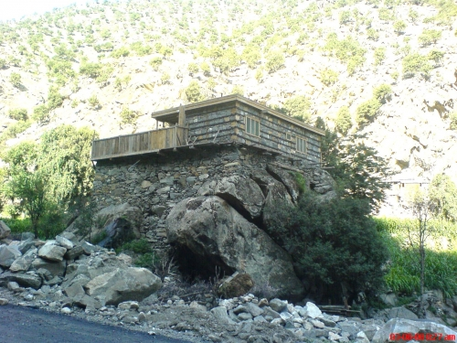
Stone and Timber Houses

Slide 61
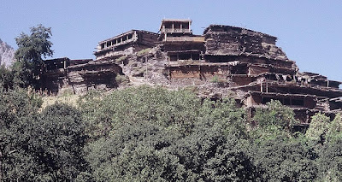
Stone and Timber houses of Kailash

Slide 62
Design Determinants
Following are the design determinants:
1. Environmental Control
2. Expression

Slide 63
1. Environmental Control
An architect while designing keeps in mind the natural environmental elements.
Light
Heat
Humidity
Air
Wind
Sound

Slide 64
2. Expression
Expression is the key factors in the design of a building.
Ornamental
Symbolic

Slide 65
Role of an Architect
An architect is a vital part of our society.
He helps in building our society.
An architect must possess an aesthetic sense combined with a practical approach to design a building.
An architect through his designs narrates the cultural and social aspect of our society.
An architect design homes, working space etc for people according to their needs and comfort.

